Slide 1

Predicting Flight On-Time Performance
Ariffin Sarhid
DSIF 2
Capstone

Slide 2
TABLE OF CONTENTS
01.
04.
Problem Statement
Feature Engineering
02.
05.
Data Cleaning
Model Performance
03.
06.
Data Exploratory
Opportunity for Improvement

Slide 3

01.
Background & Problem Statement

Slide 4
Background
Flight insurance is designed to protect the cost of your flight. Generally, some of the common problems that are covered in a flight insurance are flight cancellations, unexpected flight delays, or mid flight diversion. Insurance companies usually have difficulty in predicting these events. Having a model to predict the likelihood of these events may help the insurance companies to set a competitive premium for its insurance product.

Slide 5
Problem Statement
To predict the On-Time performance of a given flight by using classification model. Model will be evaluated based on Test Accuracy score and Recall.

Slide 6
02.
Data Cleaning

Slide 7
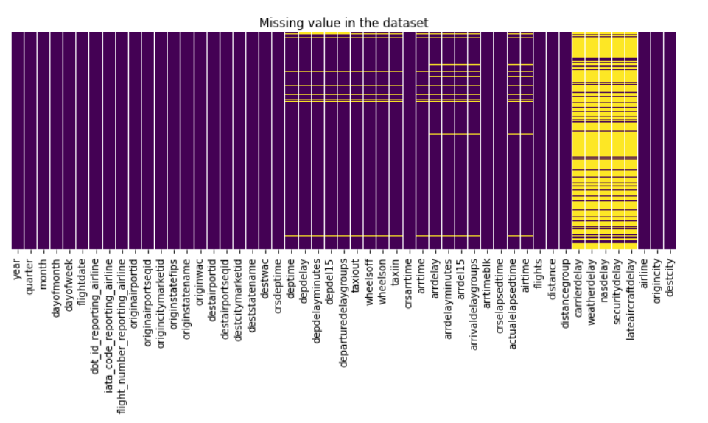
Data Cleaning
2 Datasets
Merged Both Datasets
Null Values
01
02
03
Flight Details – include departure and arrival information
Airline Code Description
Data from Bureau Transportation Statistics
Merge Airline Delay dataset and Airline Code Description
2.5% of 89009 rows were drop

Slide 8
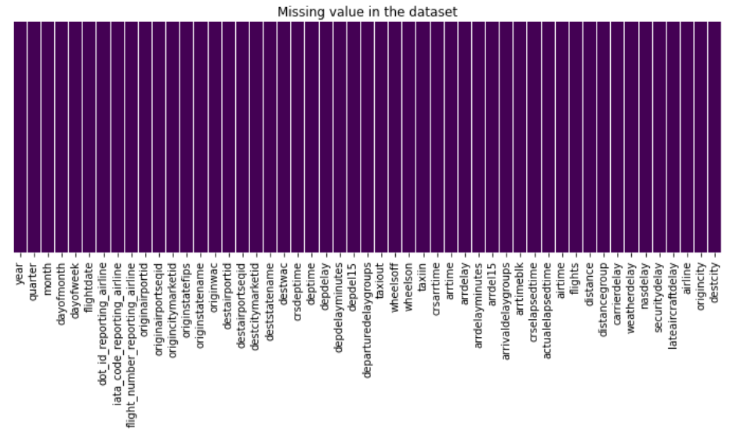
Data Cleaning
Clean Columns
Drop Columns
04
05
Replace ‘ ‘ with ‘_’
Lowercase
Columns with non-unique information were dropped.
df.shape
(86761,51)

Slide 9


Data Exploratory
Images reveal large amounts of data, so remember: use an image instead of a long text. Your audience will appreciate it

Slide 10
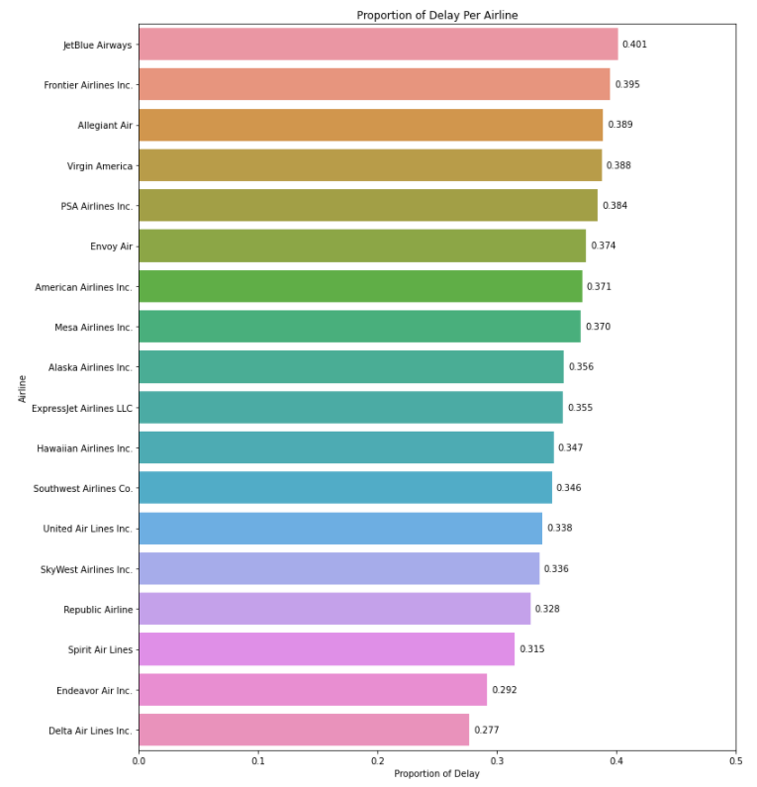
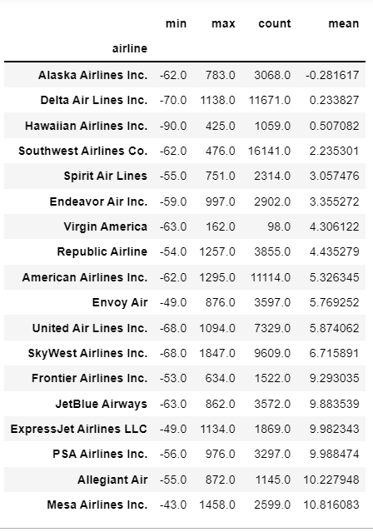

Slide 11
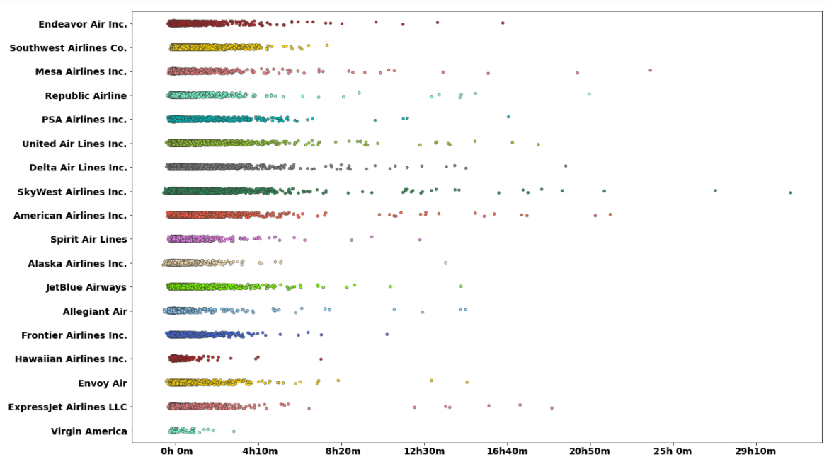

Slide 12
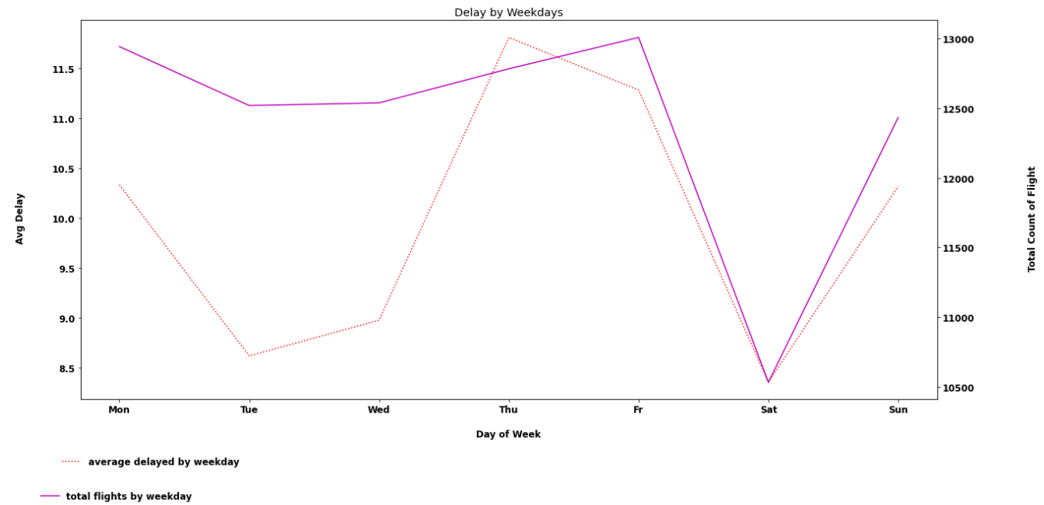

Slide 13
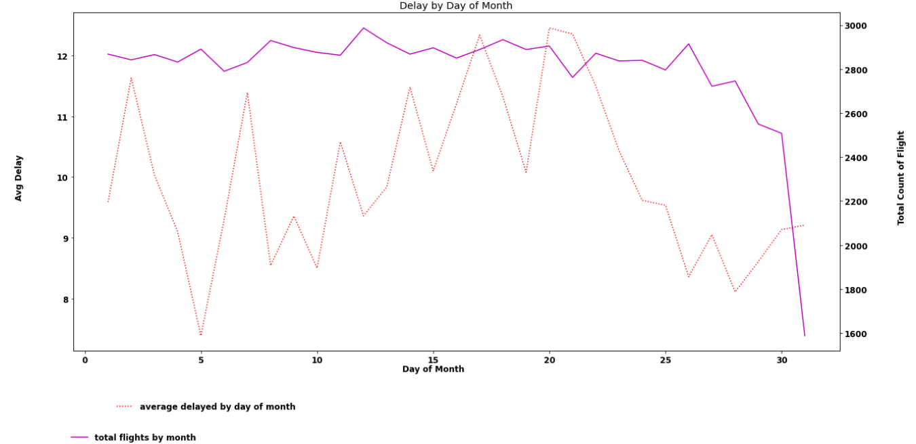

Slide 14
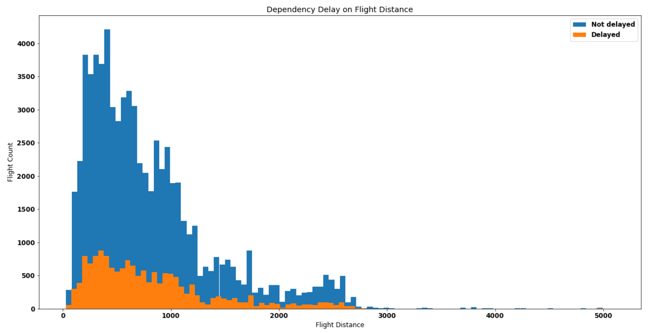

Slide 15
04.
Feature Engineering

Slide 16
Feature Engineering
One Hot Encoder
Selecting Features
Polynomial Feature
Dummify Destination City(‘object’)
Feature Selection based on domain knowledge the information available before departure
Polynomial feature on best 10 feature importance to improve model performance

Slide 17
05.
Model Performance

Slide 18
Model Performance
Model | Train Score | Test Score | Recall | ROC-AUC
Logistic Regression | 65.6% | 65% | 61% | 65.1%
Random Forest | 64.4% | 62.6% | 69% | 62.9%
First Run
Model | Train Score | Test Score | Recall | ROC-AUC
Logistic Regression | 64.5% | 63.8% | 59% | 64.2%
Random Forest | 63.8% | 63.3% | 67% | 63.1%
Second Run

Slide 19
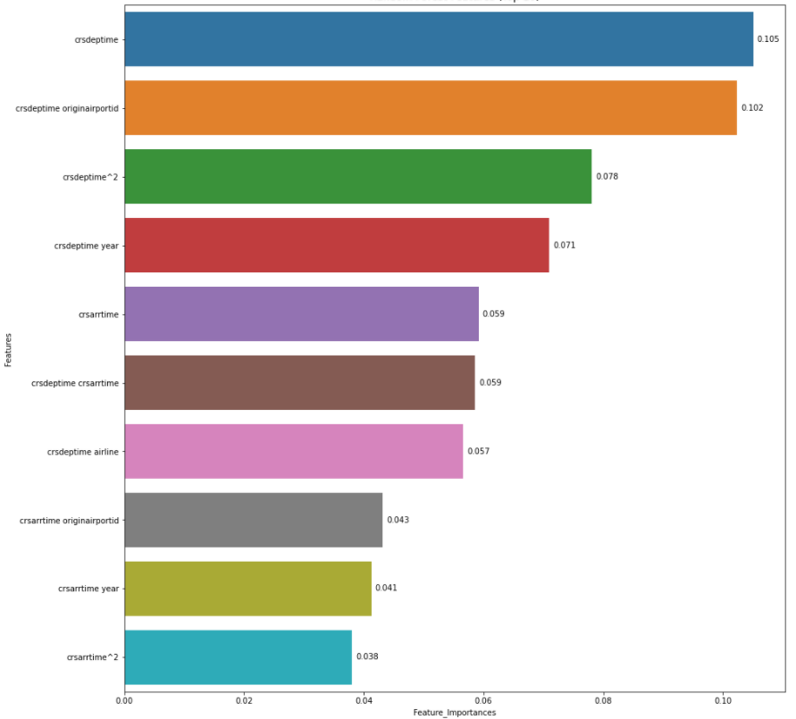
Best Features
2nd run of Random Forest

Slide 20
Opportunity for Improvement
Run other classification model such as Gradient Boost or a much simpler one i.e Decision Tree
Project has the potential to go beyond by predicting the minutes delay.
Further study on the dataset from Covid impact.

Slide 21
THANKS
Do you have any questions?
ariffinsarhid@gmail.com
https://github.com/ariffinsarhid
https://www.linkedin.com/in/ariffin-sarhid/

